Slide 1

World-wide Energy Consumption & Emission Analysis
Presented by:
D Sagar
K Ritesh
CH Chaitanya

Slide 2
About Us
1 . Name : Dandoti Sagar
Background : B.tech(Electronics and Communication Engineering)
Linked in: www.linkedin.com/in/dandotisagar
GitHub : https://github.com/Sagar18122002
2. Name : Ritesh
Background : B.Tech (Electronics and Communication Engineering)
Linked in: https://www.linkedin.com/in/RiteshKothagattu
GitHub : https://github.com/riteshkothagattu
3. Name : Chaitanya
Background : B.Tech ( Computer Science & Engineering )
Linked in: https://www.linkedin.com/in/chaitanyachimakurthy
GitHub : https://github.com/Chaitanya-dhop

Slide 3
Introduction
This project centers around the examination of global data concerning energy generation, consumption, emissions, GDP, and population through SQL queries.
The database comprises several interrelated tables, which help to explore how energy use affects the development of countries and their impact on the environment. This enables monitoring of sales and revenues to facilitate decision-making and ensure adequate availability of products.
By carrying out SQL commands such as year-to-year comparison, energy balance (generation/consumption), emission statistics, and per capita calculations, this project reveals significant trends for different nations.
Overall, this project strives to convert the raw data into valuable information about the issues related to energy sustainability and its economic significance, as well as emissions at large.

Slide 4
Objective of the Project
Explore the link between the generation, use, and emissions of energy among nations.
Locate the highest performing nations in terms of GDP and investigate their energy habits.
Determine the energy balance (whether surplus or deficit) based on data of generation and consumption of energy.
Compare the changes from year to year in terms of emissions, GDP, and energy consumption.
Conduct per capita analysis."
Calculate important ratios such as the emission-to-GDP ratio.

Slide 5


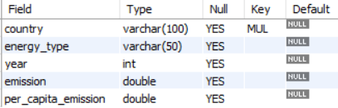
ABOUT TABLES
Country Table
Population_3 Table
Emission_3 Table

Slide 6
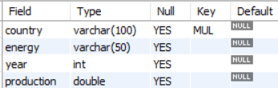

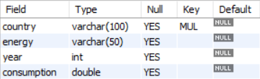
Production_3 Table
gdp_3 Table
Consum_3 Table

Slide 7
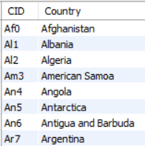
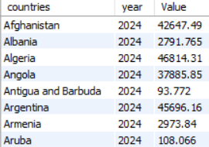
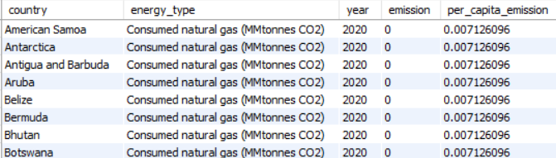
Sample inserted values:
Country Table
Population_3 Table
Emission_3 Table

Slide 8
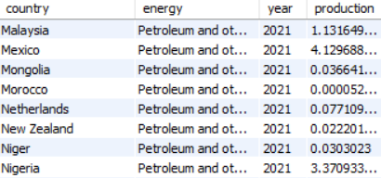
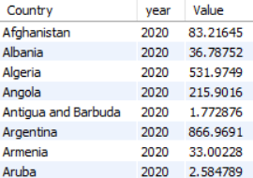
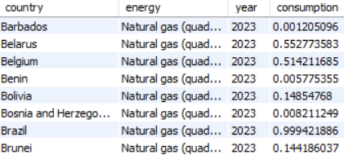
Production_3 Table
gdp_3 Table
Consum_3Table

Slide 9
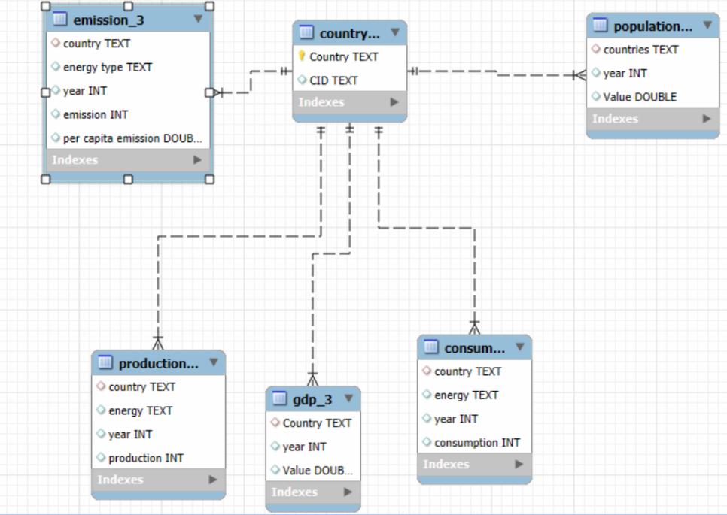
ER Diagram and schema explanation
Table relations:
● One-to-Many from country to emission_3
● One-to-Many from country to population
● One-to-Many from country to production
● One-to-Many from country to consumption
● One-to-Many from country to gdp_3

Slide 10
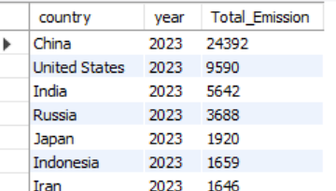
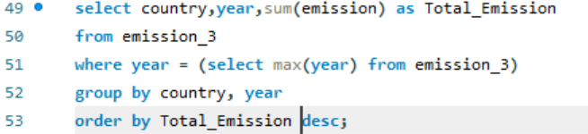
General & Comparative Analysis. 1. What is the total emission per country for the most recent year available?
Output
Query
Key Insights:
The total emissions differ widely across countries in the most recent year, with a few countries contributing significantly higher emissions while many others have relatively low levels.

Slide 11
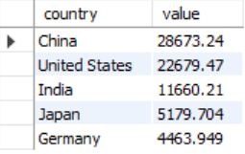
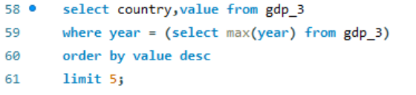
2. What are the top 5 countries by GDP in the most recent year?
Query
Output
Key Insights:
China and the United States lead global GDP rankings.
India is emerging as a strong top economy followed by Japan and germany.
Economic power is concentrated among a few countries.

Slide 12
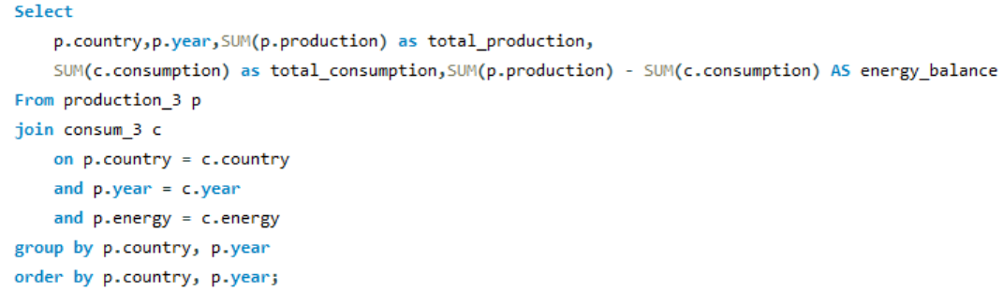
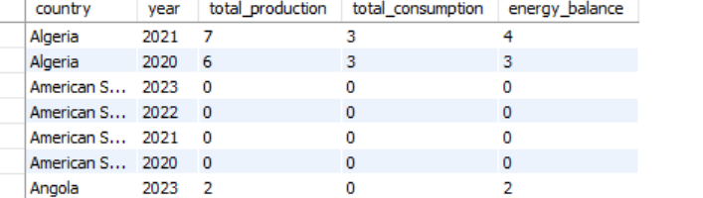
3. Compare energy production and consumption by country and year?
Query
Output
Key Insights:
Many countries show higher consumption than production, resulting in energy deficit.
Some countries have balanced or surplus energy, producing more than they consume.
Indicates dependency on energy imports for deficit countries.

Slide 13


4. Which energy types contribute most to emissions across all countries?
Query
Output
Key Insights:
Coal and coke contribute the highest emissions
Petroleum and other liquids are also major contributors
Natural gas contributes significantly but less than coal
Shows that fossil fuels dominate global emissions

Slide 14
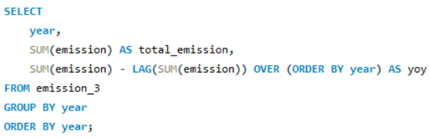
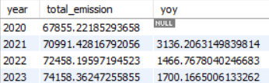
Trend Analysis Over Time 1. How have global emissions changed year over year?
Query
Output
Key Insights:
Global emissions show a consistent increasing trend over the years.
There is a positive year-over-year growth, indicating rising emissions.
Suggests increasing energy usage and environmental impact globally

Slide 15
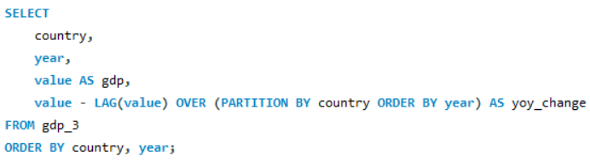
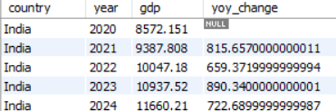
2. What is the trend in GDP for each country over the given years?
Query
Output
Key Insights:
Most countries show a steady increase in GDP from 2020–2024, indicating economic recovery and growth after 2020
Some countries (e.g., Afghanistan, Lebanon) show a declining or fluctuating trend due to instability.
A few countries experience temporary drops followed by recovery, showing economic shocks and rebounds.
Overall, the global trend is positive growth with minor fluctuations across year

Slide 16
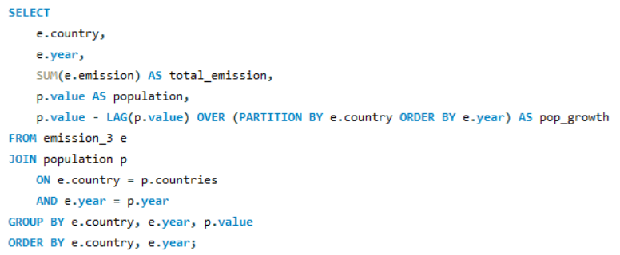
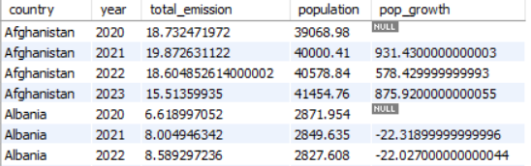
3. How has population growth affected total emissions in each country?
Query
Output
Key Insights:
In many countries, increase in population leads to higher emissions
Some countries show emission changes even with stable population, indicating other factors
Overall, population growth has a positive impact on total emissions

Slide 17
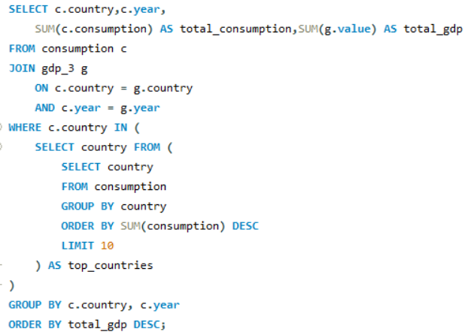
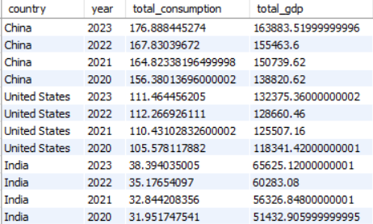
4. Has energy consumption increased or decreased over the years for major economies?
Output
Query
Key Insights:
Most major economies show increasing energy consumption over time.
China and India have the strongest growth.
Germany, Japan, and Russia show slight decline or fluctuation.

Slide 18
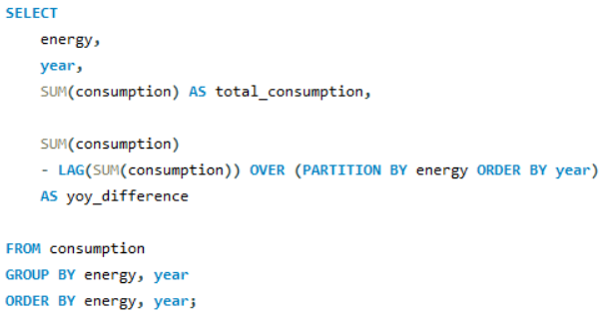
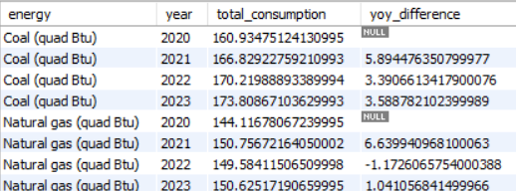
5.Which energy sources show the fastest growth in consumption over time across all countries?
Query
Output
Key Insights:
Petroleum and other liquids show the fastest and most consistent growth with the highest increases.
Natural gas grows quickly but is unstable with fluctuations over time.
Renewables grow steadily, indicating a gradual shift toward clean energy.

Slide 19
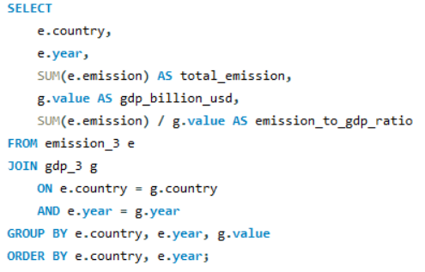
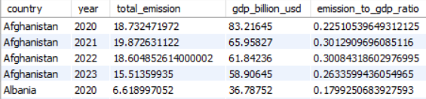
Ratio & Per Capita Analysis. 1. What is the emission-to-GDP ratio for each country by year? Query
Output
Key Insights:
Emission-to-GDP ratio varies widely across countries and years .
Higher ratios indicate more emission-intensive economies, while lower ratios show better sustainability
Some countries show improvement over time with decreasing ratios

Slide 20
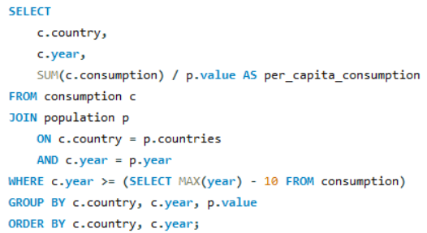
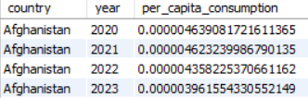
2. What is the energy consumption per capita for each country over the last decade?
Query
Output
Key Insights:
Countries like Qatar, UAE, and Bahrain show very high per capita energy consumption.
Developed and resource-rich countries generally have higher consumption per person
Developing countries show lower consumption, indicating limited access and usage

Slide 21
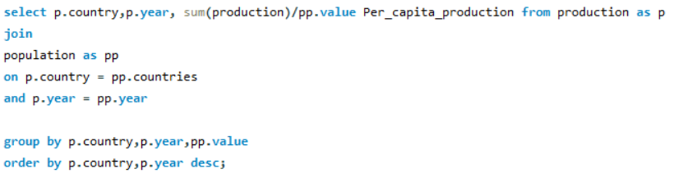
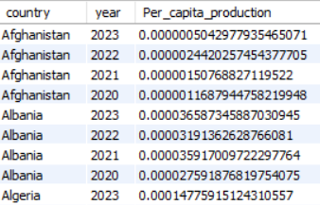
3. How does energy production per capita vary across countries? Query Output
Key Insights:
Countries like Qatar, Kuwait, and Norway have very high energy production per capita.
Developed/resource-rich countries produce more energy per person.
Many countries show very low values, indicating limited production or high population.

Slide 22
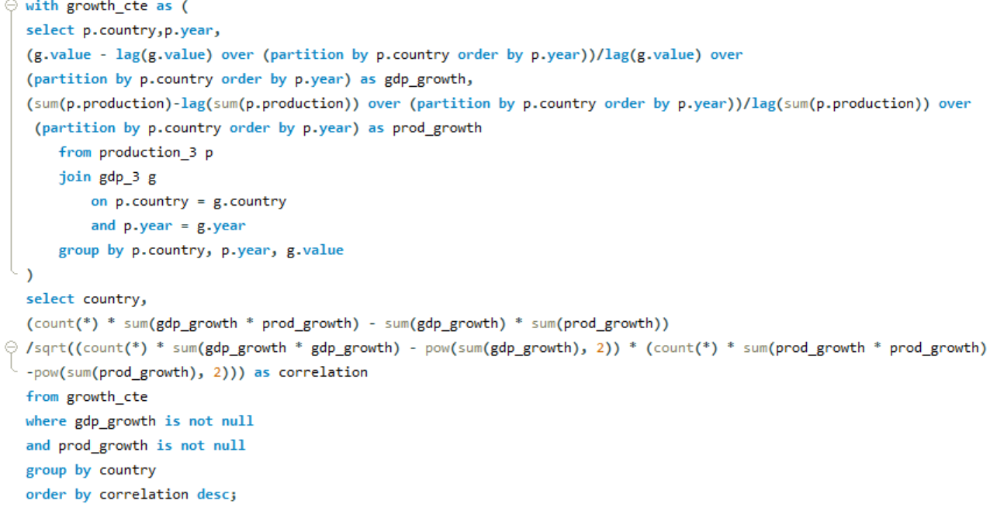
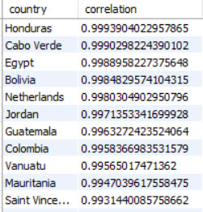
4. What is the correlation between GDP growth and energy production growth?
Query Output
Key Insights:
Countries like Honduras, Cabo Verde, Egypt, and Bolivia have the highest energy consumption relative to GDP
High values indicate energy-intensive economies with lower efficiency
Some developed countries (e.g., Netherlands, Spain) also show high ratios due to industrial activity
Overall, higher ratio means more energy is used to generate economic output

Slide 23
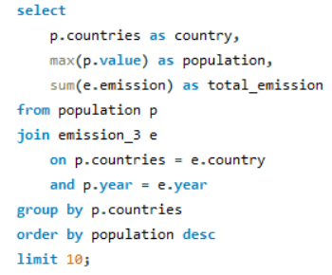
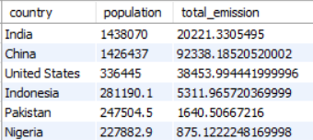
Global Comparisons 1. What are the top 10 countries by population and how do their emissions compare? Query
Output
Key Insights:
China and the United States have the highest emissions among top populated countries
India has a large population but lower emissions compared to them
Countries like Pakistan, Nigeria, and Bangladesh have high population but low emissions

Slide 24
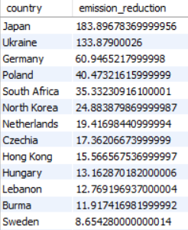
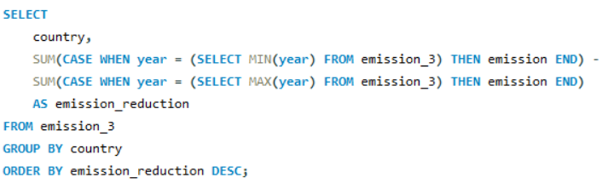
2. Which countries have reduced their total emissions the most over time? Query
Output
Key Insights:
China, India, and the United States show the highest emission reductions.
Large economies dominate the reduction trend.
Small countries show very minimal changes.

Slide 25
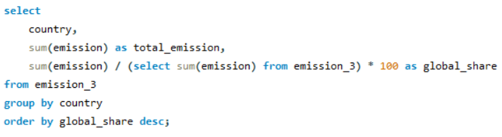
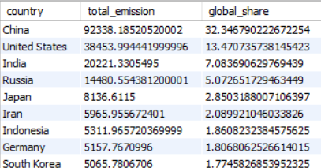
3. What is the global share (%) of emissions by country?
Query
Output
Key Insights:
China (~32%) and United States (~13%) contribute the largest share of global emissions.
India (~7%) and Russia (~5%) are also major contributors.
Most other countries contribute less than 2% each, showing emissions are concentrated in a few nations.

Slide 26
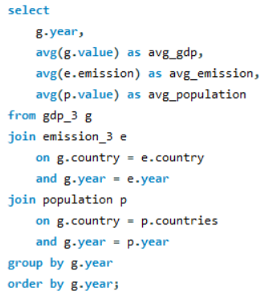
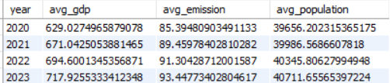
4. What is the global average GDP, emission, and population by year?
Query
Output
Key Insights:
Global average GDP, emissions, and population show a steady increase from 2020 to 2023.
This indicates overall economic growth along with rising environmental impact.

Slide 27
Key Insights and Recommendations
Global emissions are continuously increasing, mainly driven by fossil fuel consumption like coal and petroleum.
Coal and petroleum remain the largest contributors to global emissions, highlighting dependence on non-renewable energy.
Major economies like China, United States, India, and Russia dominate global emissions, contributing a significant share.
GDP growth is strongly linked with energy consumption, meaning higher economic activity leads to higher energy demand.
Countries with higher GDP generally consume more energy, increasing their environmental impact.
Population growth directly increases energy demand and emissions, especially in developing countries.

Slide 28
Key Insights and Recommendations
Many countries face energy deficits (consumption > production), leading to high dependence on energy imports.
Resource-rich countries achieve higher energy production per capita, giving them better energy security.
Per capita emission analysis reveals global inequality, where some countries emit far more per person than others.
Sustainable future requires a balance of renewable energy adoption, energy efficiency, and strong policy implementation, as energy, economy, and emissions are deeply interconnected.

Slide 29
Conclusion
There is an increase in both the energy consumption and the greenhouse gas emissions of the planet, as there is economic development and population growth at the same time. While there are certain nations whose emissions are high, most other nations have lesser impacts. The increased need for energy demonstrates the relationship that exists between growth and consumption.

Slide 30
Challenges Faced
Handling missing or incomplete data across multiple datasets made analysis difficult and required careful data cleaning and preprocessing.
Ensuring consistency between datasets (like matching country names and years) was challenging and important to avoid incorrect results.
Optimizing SQL queries for performance became necessary when working with large datasets and complex joins.
Interpreting insights from visualizations and ensuring they align with query results required critical thinking and validation.

Slide 31


THANK
YOU

